Slide 1
Advanced pcb lab
Marvin the hackbot

Slide 2
Secondary micro controller
Purpose
Generating motor driver pwm
Controlling motordriver
Controlling hc-sr04
sending data to the main microcontroller

Slide 3
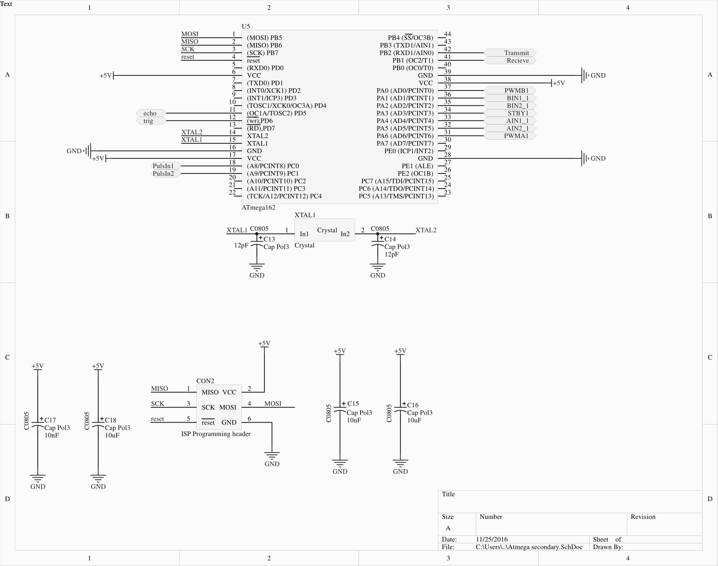

Slide 4
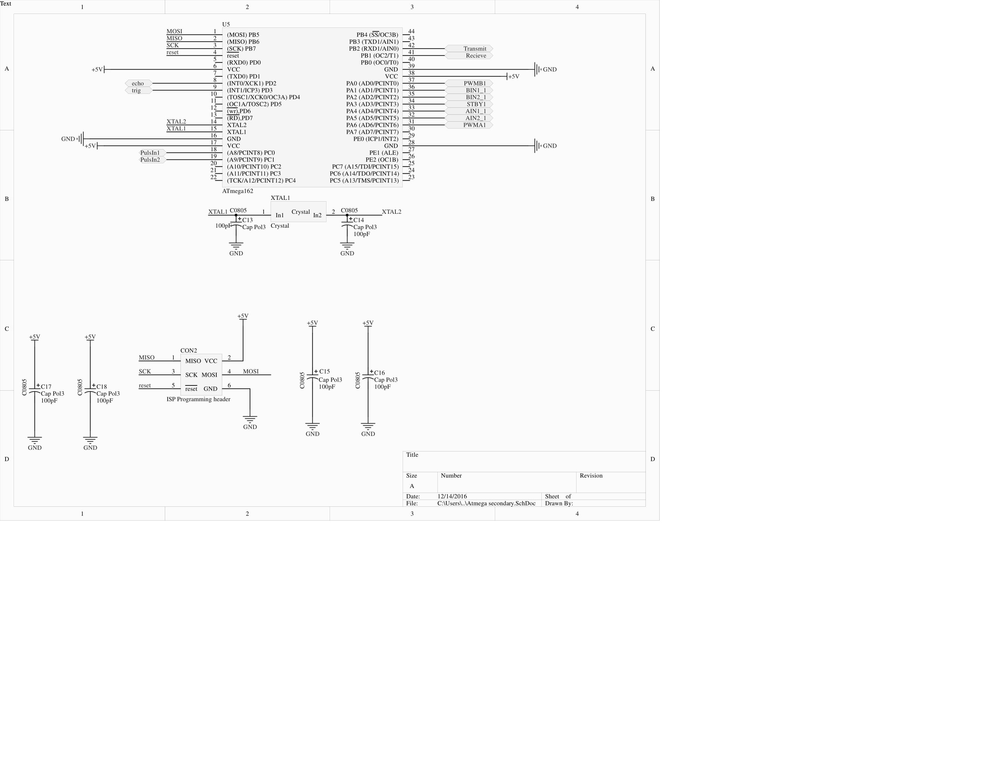

Slide 5
Main micro controller
Purpose
Generating data for esp8266
Controlling levelshifter
Controlling hc-sr04
receiving data from the secondary controller

Slide 6
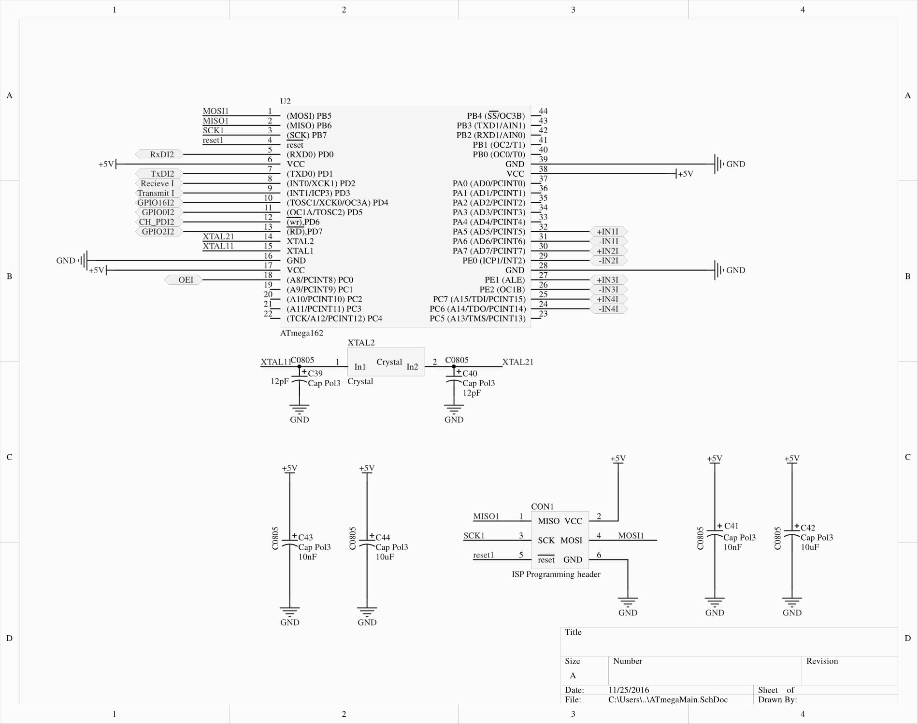

Slide 7
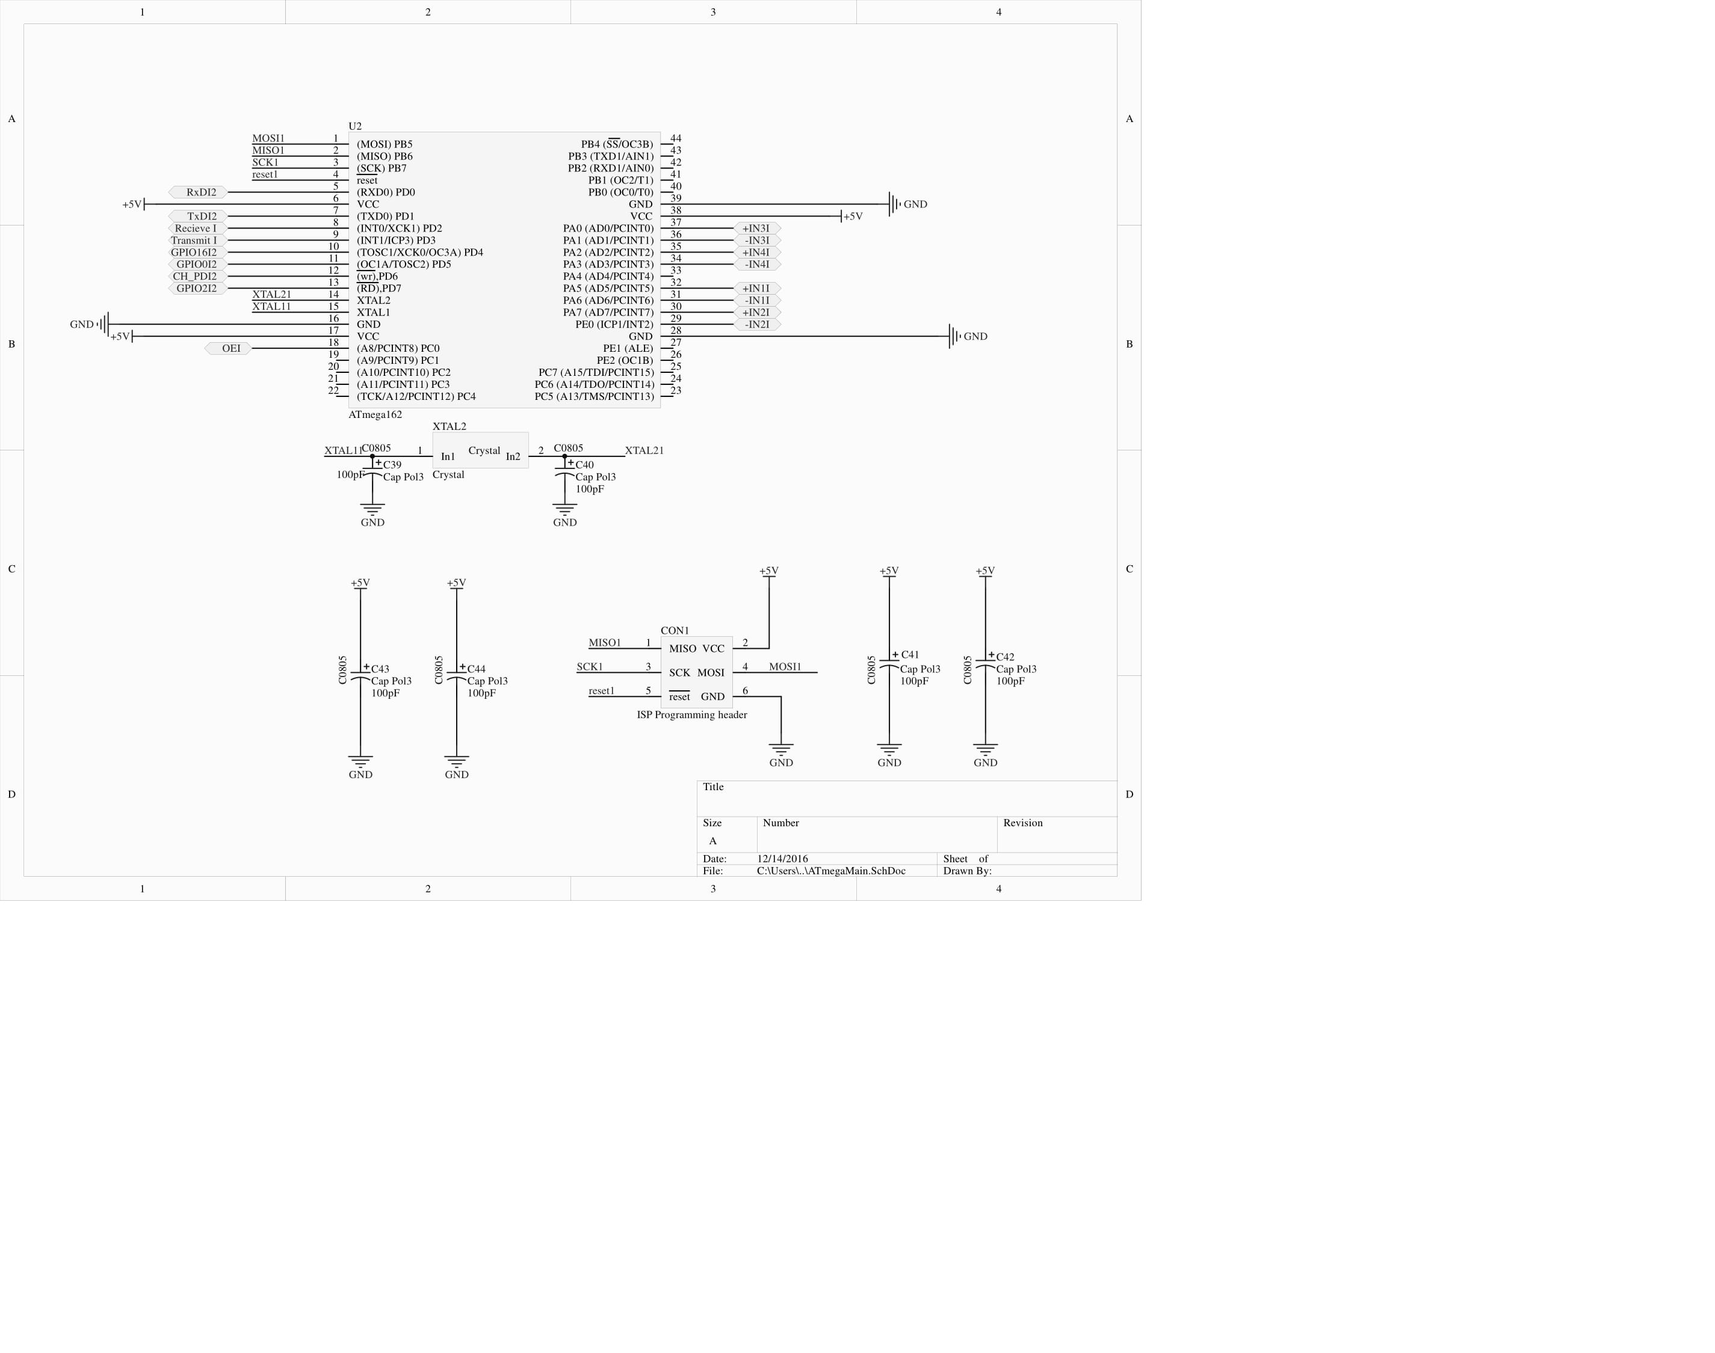

Slide 8
Why to microcontrollers?
Taking load of the controller(interrupt wise)
Relatively more i/o available

Slide 9
Encoders
Rover chassis=> quadrature encoders
Number of sensors can be used
Optical(IR pair) => whit black and withe surfaces
Magnetical(hal sensor) => magnet on a shaft
Pulses 90degrees out of phase

Slide 10
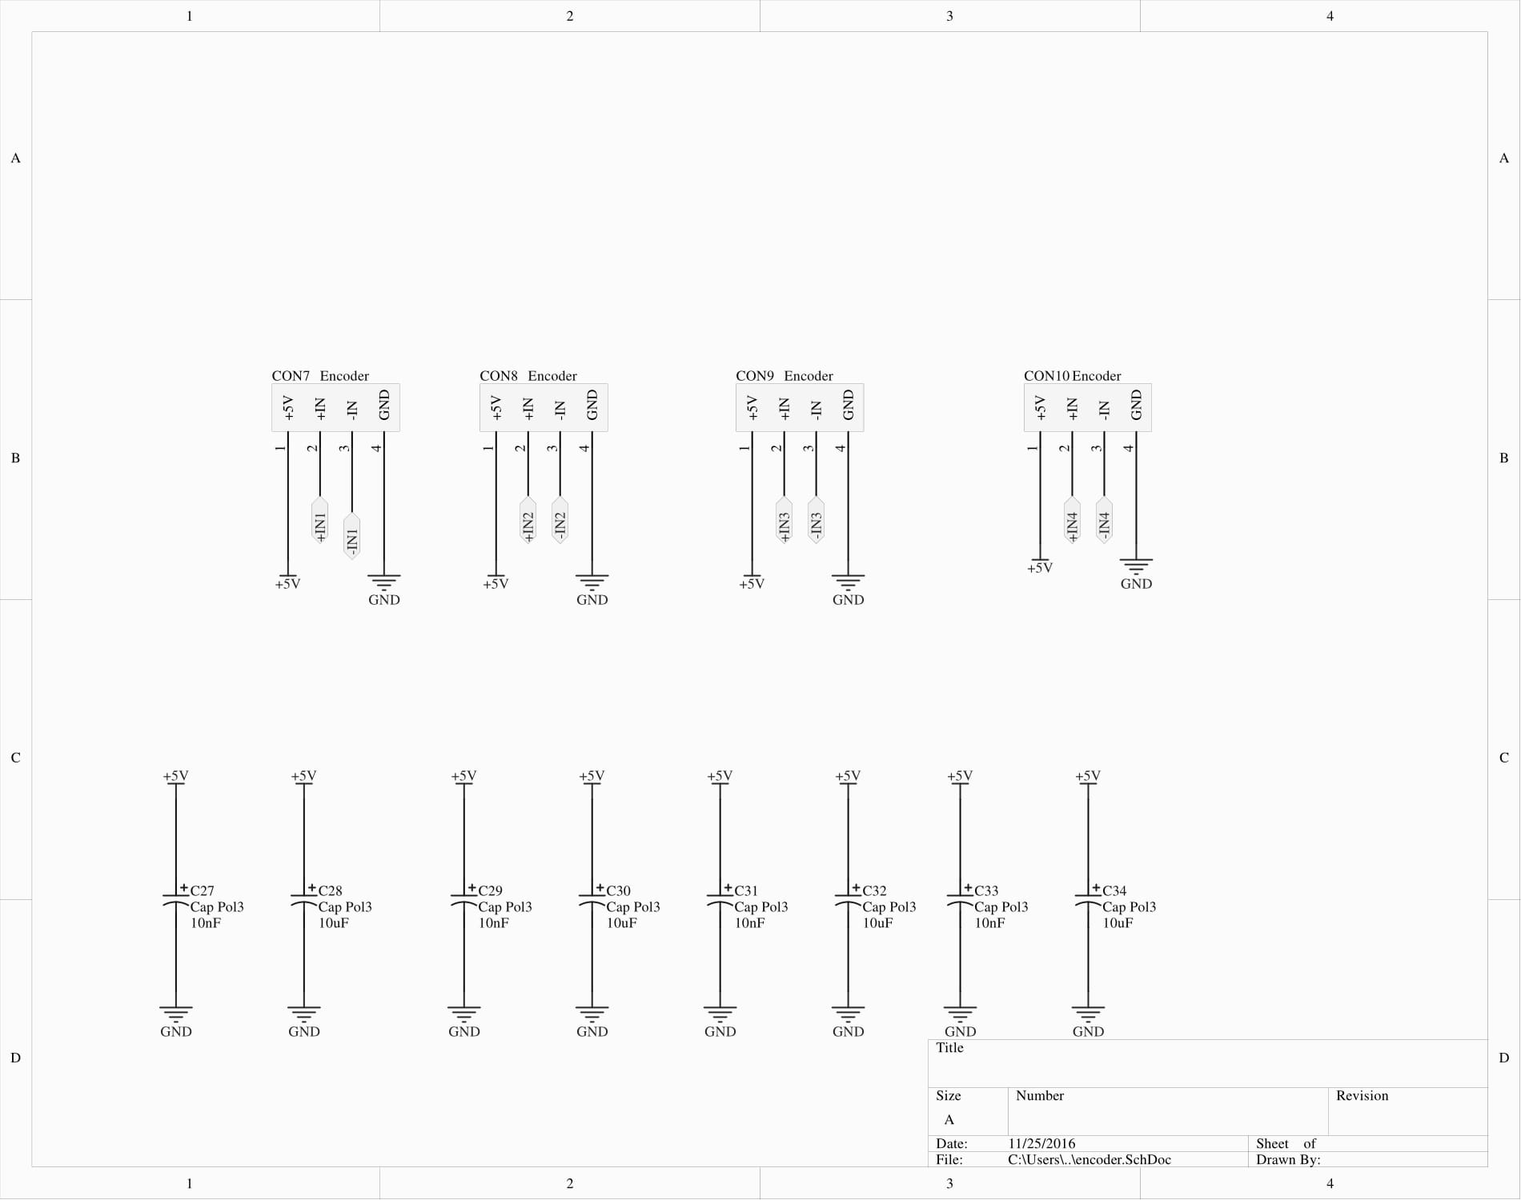

Slide 11
ESP8266
Cheap wifi module
with onboard System On chip
Communicating protocol=> AT commands via serial port
No components under the antenna!
3.3V ONLY!!! No 5V tolerant I/O

Slide 12
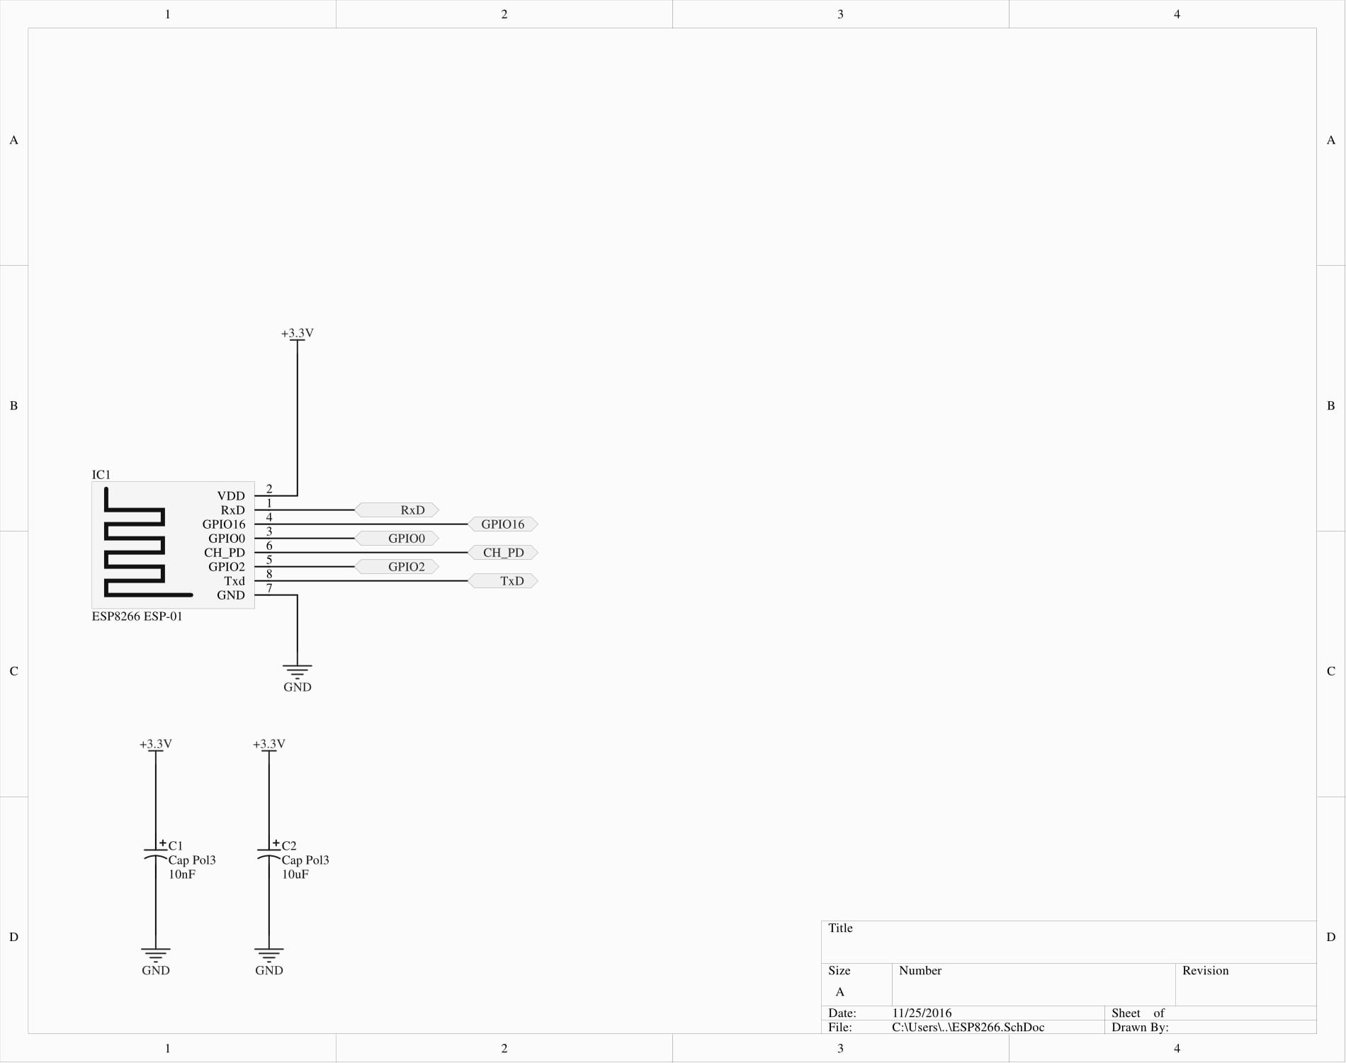

Slide 13
Level shifter
Converts signal other voltage level
For example 3.3V to 5V
TXB0108 uses 2 voltage supply’s
Vcca => 1.2V to 3.6V
Vccb =>1.65V to 5.5V
Needs to be used because of the esp8266
Level shifter needs to be enabled via OE pin

Slide 14
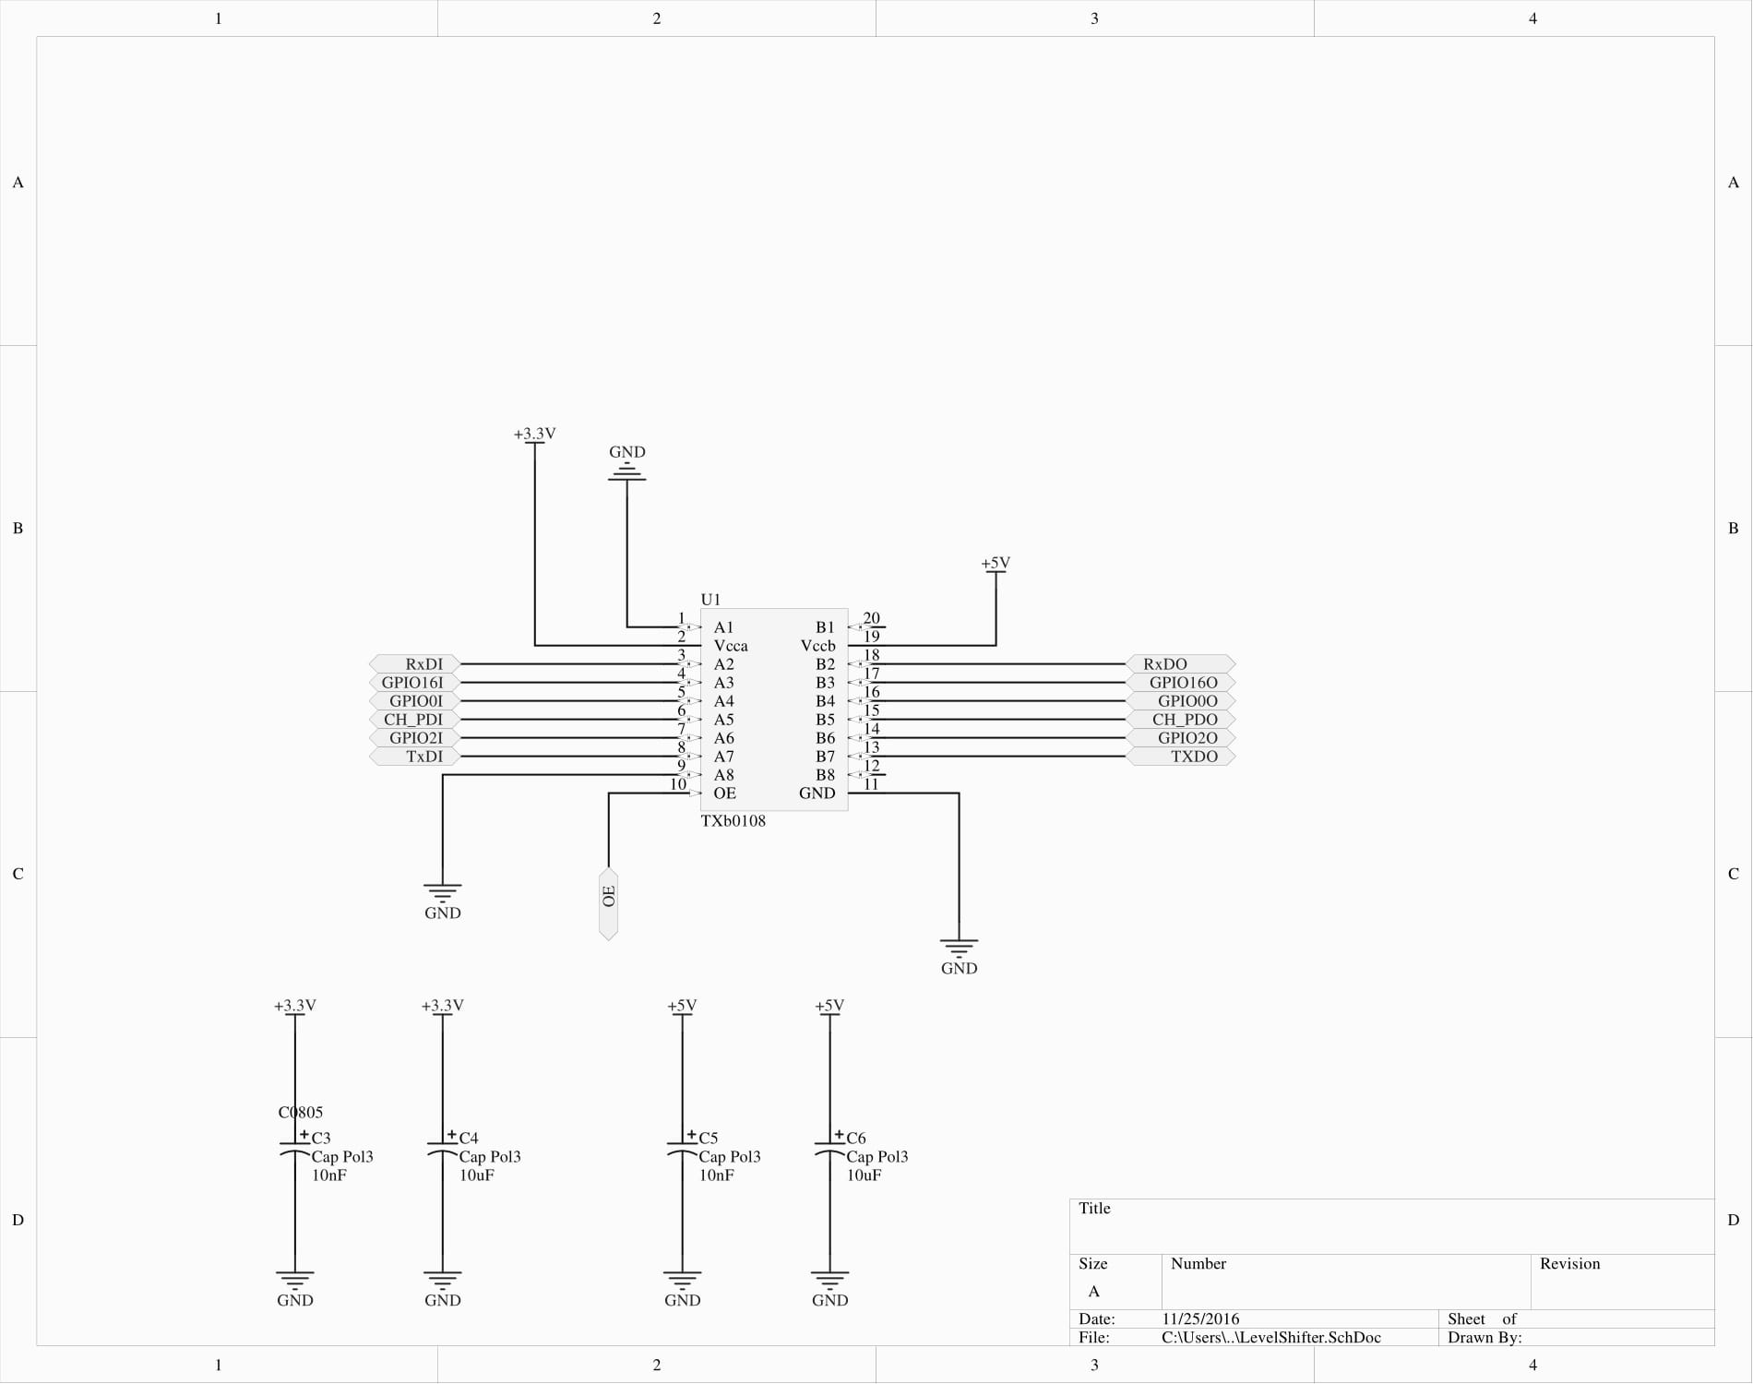

Slide 15
Motor driver
TB6612FNG
Integrated H-bridge with integrated control circuit’
No need to worry about short circuiting the internal mosfets
Iout 1.2A Max with peak current up to 3.2A

Slide 16
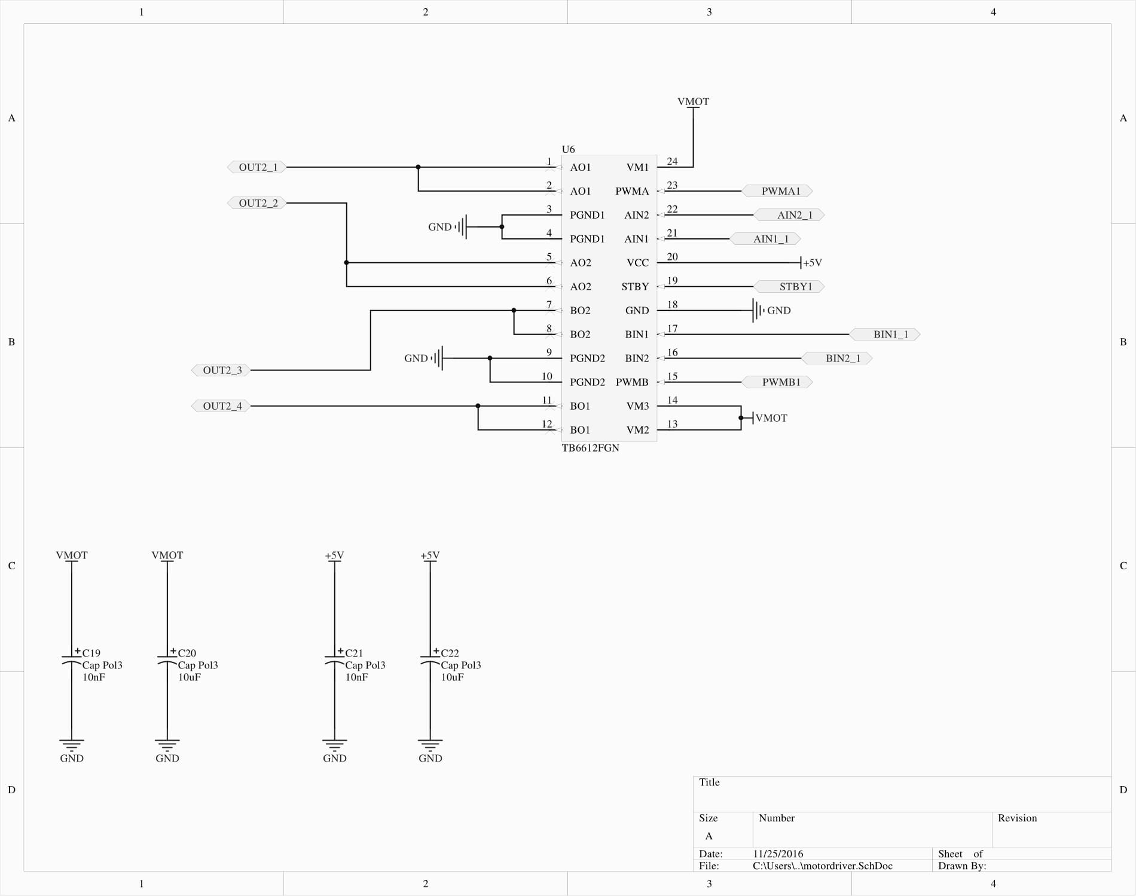

Slide 17
Rc reciever

Slide 18
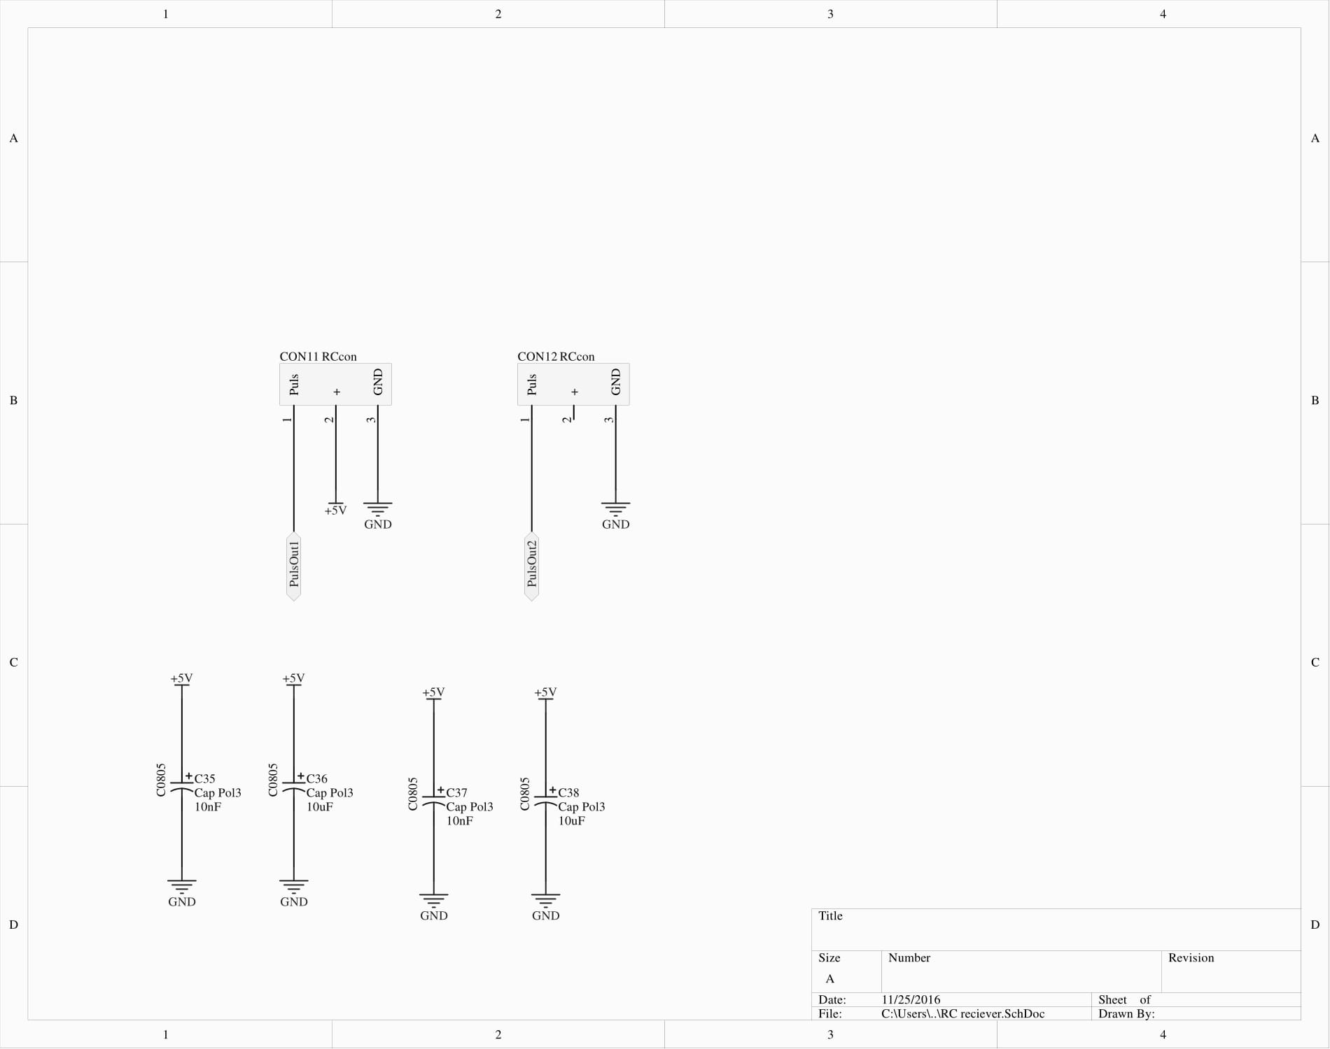

Slide 19
Ultrasonic distance sensor

Slide 20
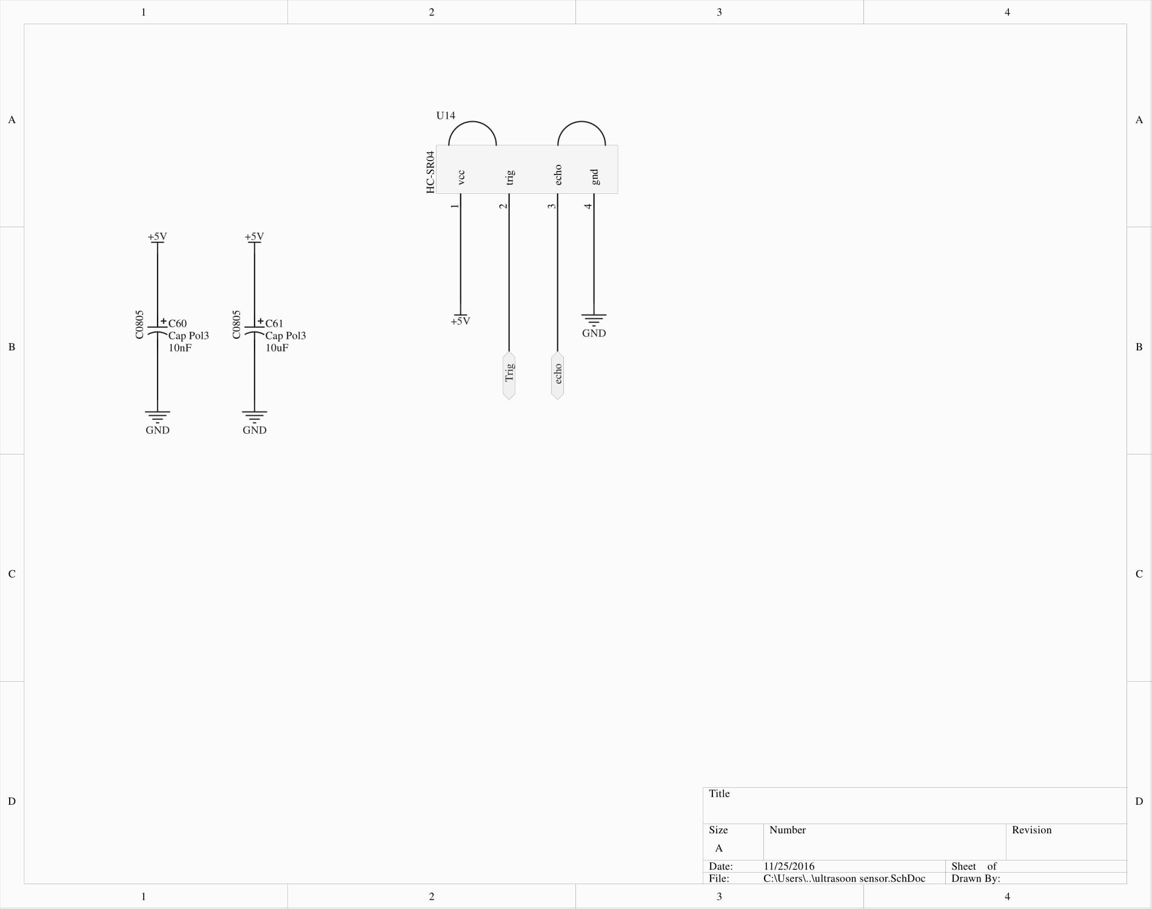

Slide 21
Power supply
Uses ldo’s
Low dropout voltage
Used to generate 5V and 3.3V for control electronics

Slide 22
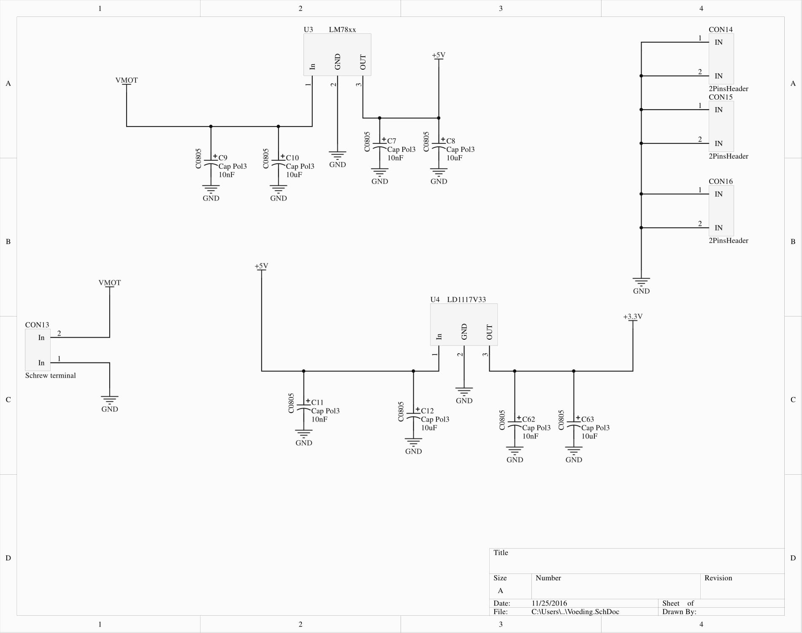

Slide 23
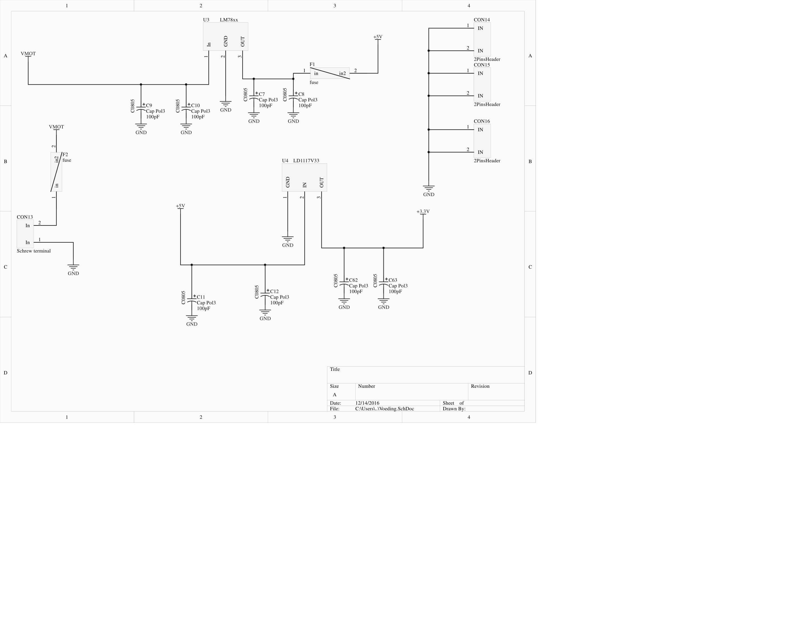

Slide 25
